Slide 1



Whitelabel The Estimation Funnel for Immoweb
A Case Study for AVIV Group
Presented By : Dibyani Sahu
Date: 9th January,2025
Aviv Group
LOGO HERE

Slide 2
OVERVIEW
Objective: To analyze the launch of the whitelabel estimation funnel for Immoweb(Belgium) and provide recommendations for success metrics, performance analysis, A/B testing, and tracking.
Entities: Se Loger, Meilleurs Agents, Immowelt
Data Source: Google Analytics, November 2022
Business Questions:
● Which success metrics do you suggest to measure for this initiative?
● At the moment which funnel performs best between Meilleurs Agents, Se Loger and Immowelt?
● Which AB tests will we implement and how will you analyse the results?
● How do you proceed to make sure the tracking will be correctly implemented?
● Draft a dashboard model that could be built to monitor the performance of the estimation funnel that will be implemented.

Slide 3

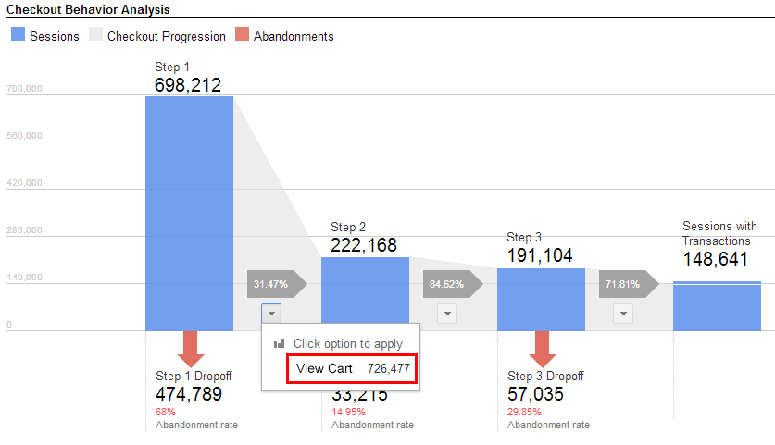
KEY SUCCESS METRICS
Metrics to Track:
Conversion Rates: Total and step-level.
Drop-Off Rates: Identifying steps with user attrition.
Total Completed Estimations: Total no.of unique estimations.
Funnel re-entry rates(open funnel): Ratio of users entering through update funnel to total no.of emails sent.

Slide 4
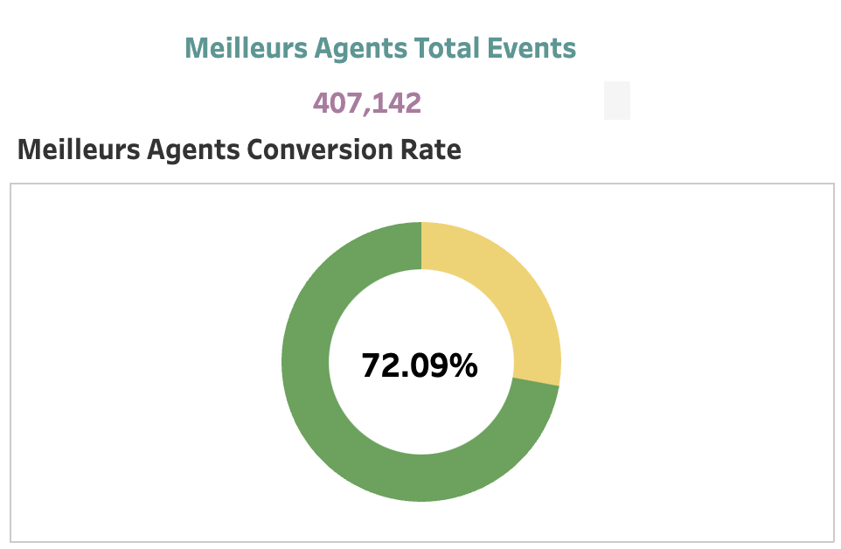
2. CURRENT FUNNEL PERFORMANCE
Meilleurs Agents(Best Performing):
Highest conversion rate: 72.09%.
Total Completed Estimations: 422399
Main drop-off: Step 2 (property type selection).
Se Loger:
Total Completed Estimations: 112976
Flat funnel: 15.93% conversion; House funnel: 56.48%.
Major drop-offs: Steps 2(flat and house), Step 17(flat) and Step 19(house).
Immowelt:
Total Completed Estimations: 19109
Conversion rate: 22.53%.
Drop-offs: Step 2 (property type selection).
Notes:
Step 17 and Step 19 are the steps immediately after the update funnel which shows significant drop in conversion indicating immediate attention.

Slide 5
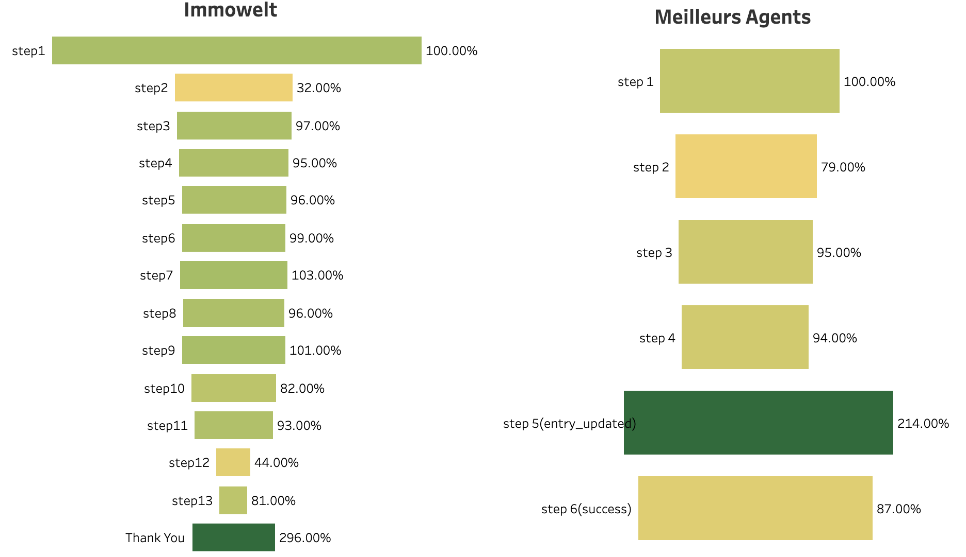
Funnel Analysis
337k
293k
Overall conversion Immowelt: 22.54%
Significant drop off at Step 2(property type) and Step 12(flat sell timeframe)
Meilleurs Agents overall conversion: 72.09%
Significant drop off at Step 2 and Success Page.
Notes:
Immowelt: Step 12(flat sell timeframe)- I am assuming that here the users are only flat users so the no.of users are less in this step. The previous step was combination of flat and house sellers.
If we can implement separate tracking for flat and house sellers then we can identify and address attrition rates specific to each group.
At the moment MA has the best funnel conversion however the conversion at Step2 can be improved by redesigning the design of the webpage at the Step2 for eg changing wording, layout, or adding a progress bar etc to make it more appealing to users and hence increase user retention.

Slide 6
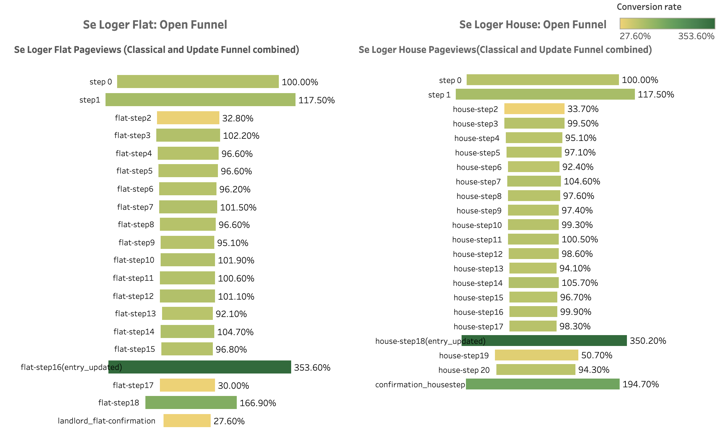
Funnel Analysis
Conversion rate Step 2 for both flat and house is around 33%. We can improve this by experimenting different variations of the webpage for example having more options like villa, duplex etc for property type.
Step 17 and Step 19 has low conversion, we can improve this by A/B testing the content and design of Update Funnel pages.

Slide 7
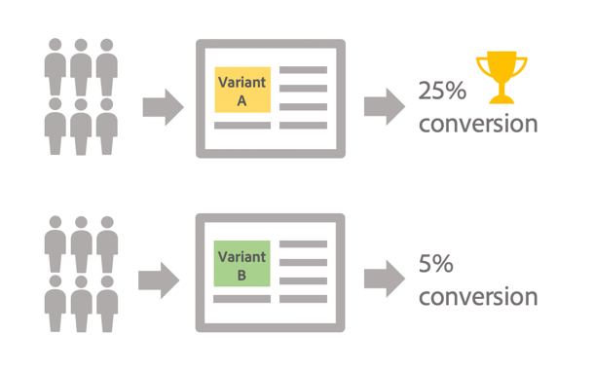
3. A/B TESTING PLAN
Goal-1: To increase conversion in step2
Hypothesis: Changing the design of the 2nd step page by giving users more options for choosing property type will increase the no.of users to complete the 2nd Step.
Control group: Step2 Page with only 2 property options - house and flat.
Treatment group: Step2 page design with additional property types (e.g.,Apartment, Duplex, Villa) and visually enhanced icons.
Success metrics: Conversion Rate at Step2.
Tracking metrics: Conversion rate, Drop off Rate, No.of users at step2.

Slide 8
A/B TESTING PLAN
Goal 2: Increase conversions through update funnel
Hypothesis: Optimized email design improves CTRs and funnel completions.
Control group: Current email design.
Treatment group: Redesigned email with enhanced visuals and optimized CTAs.
Success Metrics: CTR and Conversion Rate for Update Funnel.
Tracking metrics: i) CTR, ii)Drop off Rate iii)Email Open Rate

Slide 9
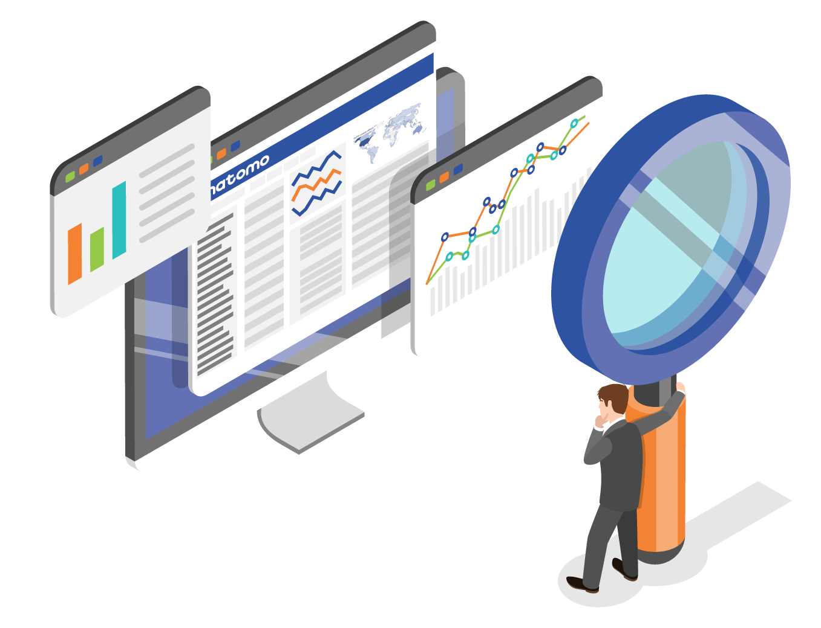
4. TRACKING IMPLEMENTATION
Steps to Ensure Accurate Tracking:
List of tracking requirements: Capturing conversions, drop-offs, clicks, property type (Flat, House, etc.), user device (mobile vs. desktop), funnel (email vs. direct entry).
Collaboration with Developers and Senior Analysts: Creating comprehensive tracking plan that outlines event names, triggers, and the data we need to capture.
Collaborate with testing team: To verify if tracking is working accurately, events are firing correctly, data is recorded as expected.
Monitor data after the tracking goes live, check for any missing values, ensuring session duration, clicks etc are captured.
Perform cross validation of the data with system logs, internal database.
Document the tracking process: Maintain documentation of the tracking procedure like steps/pages where events are tracked.

Slide 10

CONCLUSION
Summary:
Meilleurs Agents is the top-performing funnel.
Critical drop-offs at Step 2 and update funnel entries across other entities.
Recommendations:
Redesign drop-off steps.
Conduct A/B tests for emails and page designs.
Implement robust granular tracking for seller drop-offs and user behaviour for actionable insights.

Slide 11
5. Performance Monitoring Dashboard
Tableau Dashboard Link
Thank You !

